Slide 1
WBSFLIX
An interactive film suggestion platform
Data Scientist: Dante Lertora
Helene Rebelo
Sweta Bhattarai
Germany
16/02/2024

Slide 2
How WBSFLIX was build?
Recommendation Systems
Popularity Ranking
Collaborative filtering
Memory-based filtering
User-based
Item-based

Slide 3
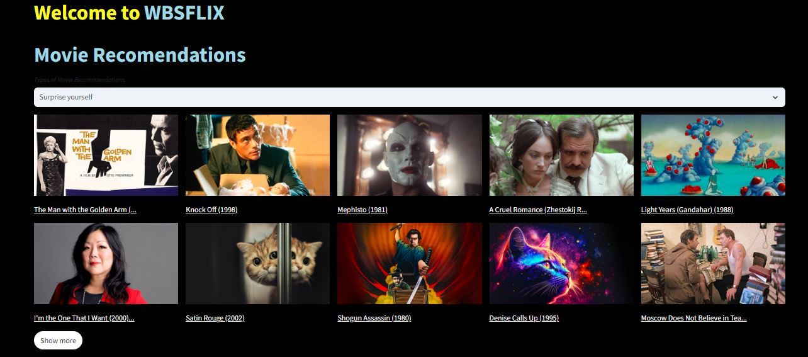
Building WBSFLIX
Streamlit

